Slide 1
Online Movie Ticket Booking

Slide 2
JPMC Java Microservices RLL - Group 7

Slide 3
Done By
ID | Name | Group
2499919 | Kapil Davey | 7
2500326 | Vandana Venkatraman Naik | 7
2500928 | Poorvi R | 7
2502861 | Venati Jaswanth | 7
2487148 | Lekkala Vikram | 7
2487418 | Dayyala Anusha | 7
2487577 | Pavan P S | 7
2487628 | Bindu K R | 7
2487890 | Punugula Udaya Jaya Lakshmi | 7

Slide 4
Project Objective
Develop a Backend Restful Web services for booking movie tickets online for different genres and languages based on Java Microservice architecture.

Slide 5
Background of the project
NMS Cinemas is a chain of single screen theatres that screen movie shows of different genres and languages at very genuine prices.
They found out that the online booking of movie tickets from apps, gaining more profit by eliminating middlemen from the equation.
Now Team decided to develop required backend RESTful Web services based on the below UI using Java Microservice .
The admin user will be able to Login to portal, create admin account, edit movie details like name, ticket price, language, description, and show timings.
The end user will be able register to the application, Search for movie tickets, apply filters and sort results based on different genres, add all the selected movie tickets to a cart, experience a seamless payment process.

Slide 6

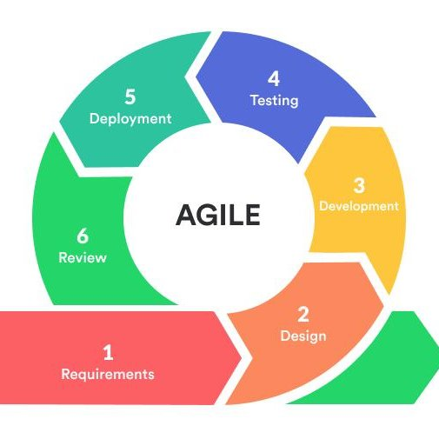


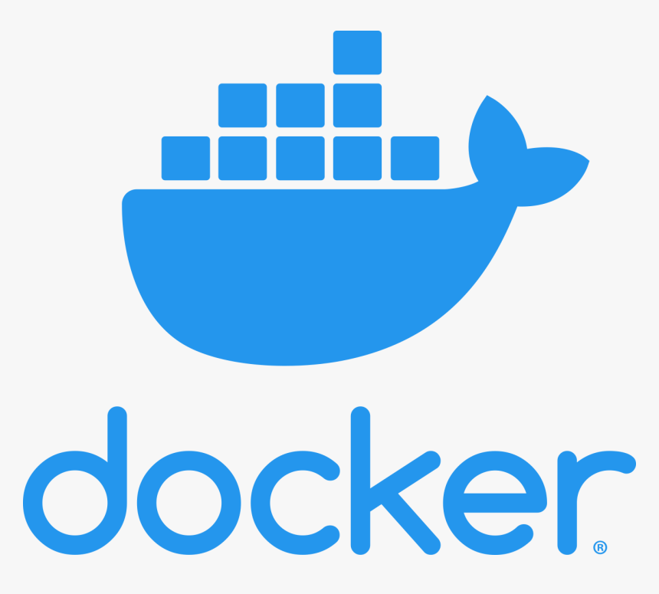



Tools and Technologies

Slide 7
Spring Boot
Spring Boot is an open-source Java-based framework used to create a Micro Service.
It is easy to create a stand-alone and production ready spring applications using Spring Boot.
Spring Boot contains a comprehensive infrastructure support for developing a micro service
Spring Boot enables you to develop enterprise-ready applications that you can "just run".

Slide 8
Microservices
Microservices - also known as the microservice architecture - is an architectural style that structures an application as a collection of services.
The microservice architecture enables the rapid, frequent and reliable delivery of large, complex applications.
While there is no precise definition of this architectural style.
Microservices are autonomous.
Different services use different versions of the same technologies

Slide 9
Spring Cloud Config Server
The Spring Cloud Config server is an externalized configuration server in which applications and services can deposit, access, and manage all runtime configuration properties.
The Spring Config server also supports version control of the configuration properties.
The Spring Config server stores properties in a version-controlled repository such as Git or SVN.
The Git repository can be local or remote.
A highly available remote Git server is preferred for large scale distributed microservice deployments.

Slide 10
Spring Cloud Config Client
A Spring Boot application can take immediate advantage of the Spring Config Server (or other external property sources provided by the application developer).
It also picks up some additional useful features related to Environment change events.
Spring Cloud Config Server pulls configuration for remote clients from various sources.

Slide 11
Eureka server
Eureka Server is an application that holds the information about all client-service applications.
Every Micro service will register into the Eureka server and Eureka server knows all the client applications running on each port and IP address.
Eureka Server is also known as Discovery Server.
Eureka Server comes with the bundle of Spring Cloud.
For this, we need to develop the Eureka server and run it on the default port 8761.

Slide 12
Eureka Client
Eureka Client is nothing but a microservice and we make it Eureka client using @EnableEurekaClient or @EnableDiscoveryClient and with Eureka server URL in properties, it will register itself to the Eureka server.
Eureka client comes in the Spring Cloud.
Eureka Server is an application that holds the information about all client-service applications.
Every Micro service will register into the Eureka server and Eureka server knows all the client applications running on each port and IP address.
Eureka Server is also known as Discovery Server.

Slide 13
Ribbon
Ribbon is a client-side load balancer that gives you a lot of control over the behavior of HTTP and TCP clients.
Ribbon's Client component offers a good set of configuration options such as connection timeouts, retries, retry algorithm (exponential, bounded back off) etc.
Ribbon comes built in with a pluggable and customizable Load Balancing component.
An approach to load balancing is to deliver a list of server IPs to the client, and then to have client randomly select the IP from the list on each connection. It has been claimed that client-side random load balancing tends to provide better load distribution than round-robin DNS.

Slide 14
Feign
Feign is a declarative web service client, or declarative REST client.
It makes writing web service clients easier.
To use Feign create an interface and annotate it.
It has pluggable annotation support including Feign annotations and JAX-RS annotations.
Feign also supports pluggable encoders and decoders.
Spring Cloud adds support for Spring MVC annotations and for using the same HttpMessageConverters used by default in Spring Web.
Spring Cloud integrates Ribbon and Eureka to provide a load balanced http client when using Feign.

Slide 15
Hystrix
Hystrix is a library that controls the interaction between microservices to provide latency and fault tolerance.
Additionally, it makes sense to modify the UI to let the user know that something might not have worked as expected or would take more time.
Hystrix allows us to define a fallback method for each service method.
Here one question arises that if the method throws an exception, what should be returned to the consumer? So answer is that if retrieveConfiguraions() fails, the method fallbackRetrieveConfigurations() is called. The fallback method returns the hardcoded LimitConfiguration instance.

Slide 16
Hystrix dashboard
Hystrix dashboard is a web application that provides a dashboard for monitoring applications using Hystrix.
Hystrix dashboard is not intended to be deployed on untrusted networks, or without external authentication and authorization.
To enable Hystrix dashboard, we only have to annotate our spring boot main class with @EnableHystrixDashboard.
One of the main benefits of Hystrix is the set of metrics it gathers about each HystrixCommand.
The Hystrix Dashboard displays the health of each circuit breaker in an efficient manner.

Slide 17
Docker
Docker engine is the layer on which Docker runs.
It's a lightweight runtime and tooling that manages containers, images, builds, and more.
Docker is a software platform that allows you to build, test, and deploy applications quickly.
Docker packages software into standardized units called containers that have everything the software needs to run including libraries, system tools, code, and runtime.
Using Docker, you can quickly deploy and scale applications into any environment and know your code will run.
Running Docker on AWS provides developers and admins a highly reliable, low-cost way to build, ship, and run distributed applications at any scale.

Slide 18
Docker
Using Docker lets you ship code faster, standardize application operations, seamlessly move code, and save money by improving resource utilization.
With Docker, you get a single object that can reliably run anywhere. Docker's simple and straightforward syntax gives you full control.
Wide adoption means there's a robust ecosystem of tools and off-the-shelf applications that are ready to use with Docker.
Docker works by providing a standard way to run your code. Docker is an operating system for containers.
Similar to how a virtual machine virtualizes (removes the need to directly manage) server hardware, containers virtualize the operating system of a server.

Slide 19
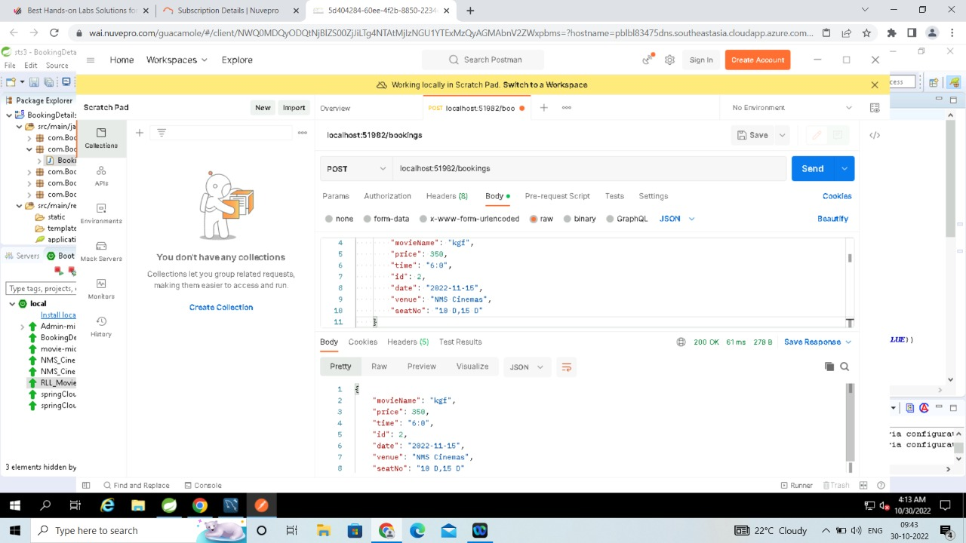
Postman Testing Screenshot (Bookings)

Slide 20
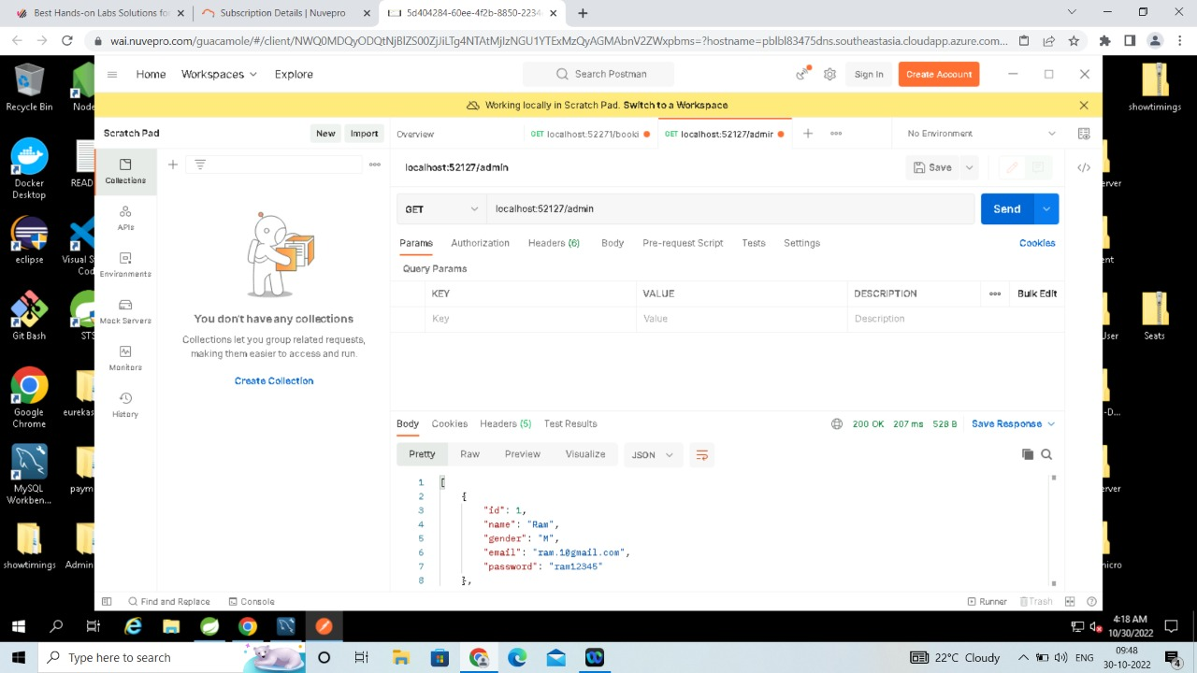
Postman Testing Screenshot (Admin)

Slide 21

Postman Testing Screenshot (User)

Slide 22
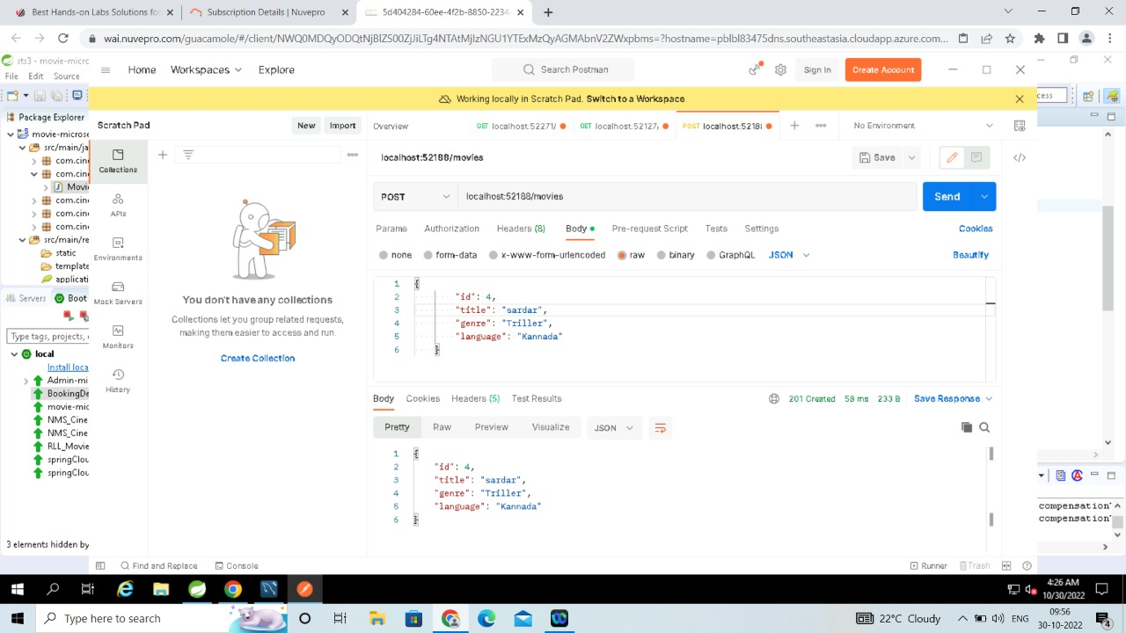
Postman Testing Screenshot (Movies)

Slide 23
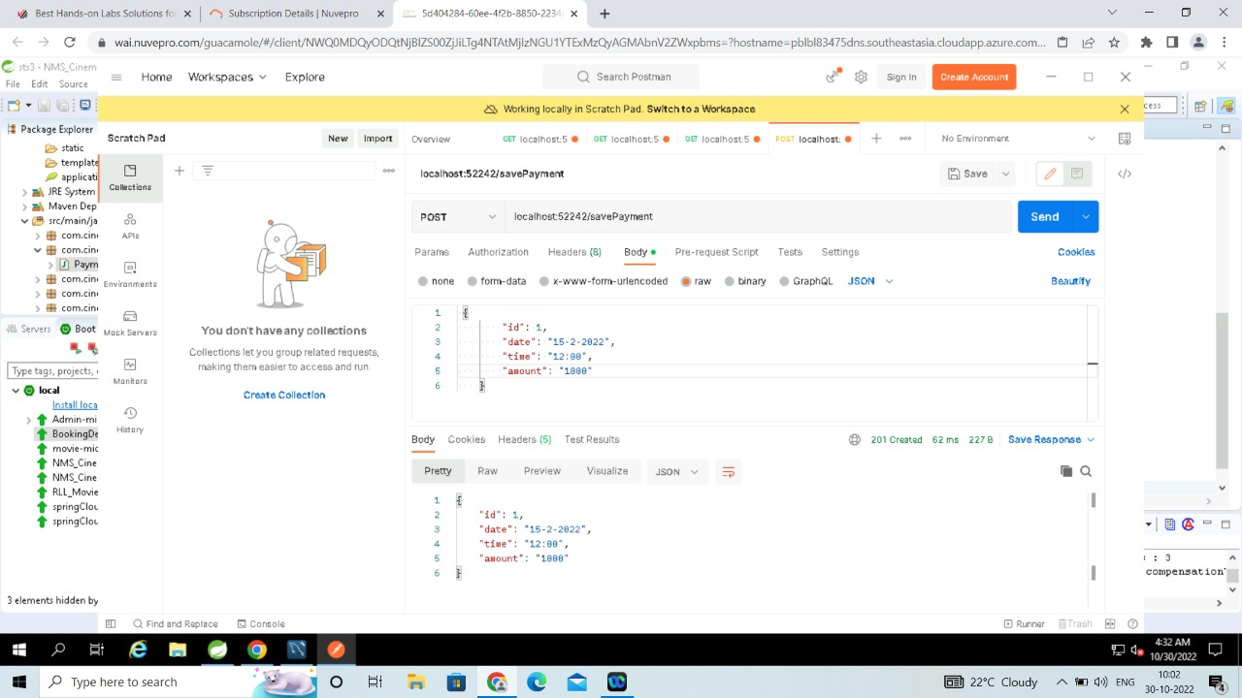
Postman Testing Screenshot (Payment)

Slide 24
Postman Testing Screenshot (Save Payment)

Slide 25
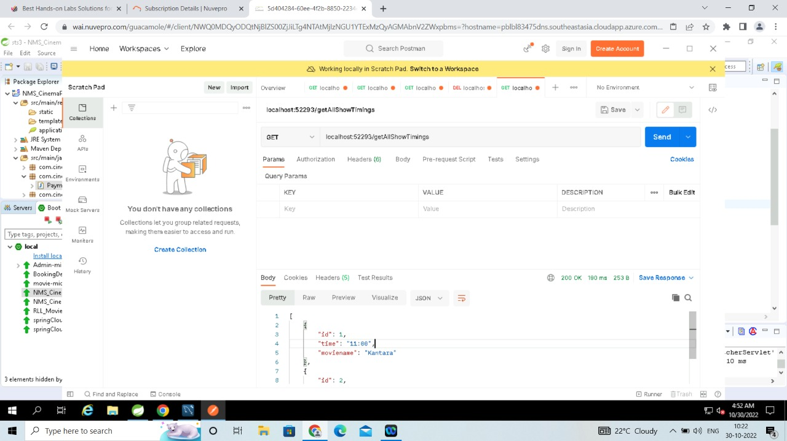
Postman Testing Screenshot (Get All Show Timings)

Slide 26
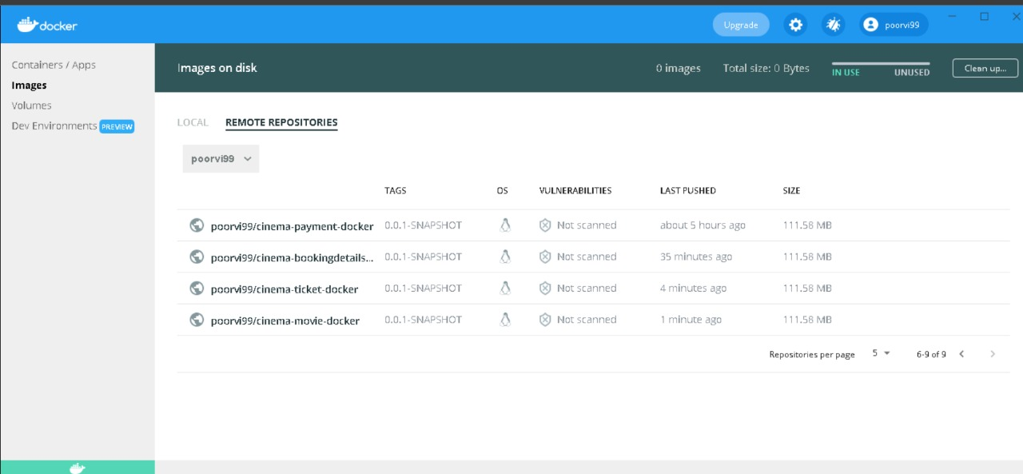
Docker Repository

Slide 27
Future scope
This project we have carried out was a learning curve for us in development of such systems. In the future we shall add more features and functionalities maintaining software engineering principles.
Further we can add a system which will allow users to rate movies after watching them in the theatre and also add comments and subsequent replies to comments to facilitate word of mouth .
We also want to Provide a list of upcoming movies so that buyers can pre-book upcoming movies.

Slide 28
Acknowledgement
We would like to thank Mphasis and Mphasis Learning Academy for organizing the RLL Team Project Program.
We also thank Mr. Manpreet Bindra, Mr. Pradeep Chinchole and Mr. Sahil Mishra for mentoring us during the whole project.

Slide 29
Thank You

